Slide 1

PROJECT TITLE: VOICE CONTROLLED BOT USING ARDUINO
Department of Computer Science and Engineering
CS8811 - PROJECT WORK
Team Members:
Students Name Reg.No:
1.SAHITHYA.A 210620104044
2.KIRUTHIKA.V 210620104029
Internal Guide: External Guide: (If Any)
MS.DHANALAKSHMI.V

Slide 2
ABSTRACT
An android application with a microcontroller is used for required tasks. The connection between the android app and the vehicle is facilitated with Bluetooth technology .
The robot is controlled by buttons on the application or by spoken commands of the user. The movement of the robot is facilitated by the two dc servo motors connected with microcontroller at the receiver side. The commands from the application is converted in to digital signals by the Bluetooth RF transmitter for an appropriate range (about 100 meters) to the robot. At the receiver end the data gets decoded by the receiver and is fed to the microcontroller which drives the DC motors for the necessary work. To implement this, we present a IOT based bot.
The aim of Voice Controlled Robotic Vehicle is to perform the required task by listening to the commands of the user. A prior preparatory session is needed for the smooth operation the robot by the user.
Keywords: Arduino, L298Dmotor, HC05 Bluetooth Module, chassis, Gear motor, Arduino application.

Slide 3
PROBLEM STATEMENT
People who are disabled and handicapped and cannot drive their own vehicle.
Amputated and handicapped people dependent to the other person
People who cannot use the GUI and Joystick.
Domain of the Project : IOT

Slide 4
OBJECTIVE
The project aims to achieve the following:
To design the robotic vehicle control using human voice
To integrate mobile application, actuators, and controllers along with wireless communication to gain good experience at training.
The Interface between the mobile application and bot is done through via Bluetooth technology.

Slide 5
INTRODUCTION
Voice controlled robotic system aims at achieving successful surveillance at places where human intervention is at high risk such as hot or sub zero temperature environment, war fields, disaster affected zone, etc. It also aims to fulfill the task assigned to the user through various commands.
Speech recognition also allows the user to perform multitasking by letting him/her concentrate on other stuff and giving the command to the machine simultaneously.
Hence, the need to accurately and efficiently controlling the robots is also increasing. There exist hundreds of methods for controlling robots.

Slide 6
EXISTING SYSTEM
The Existing system is a joystick controlled wheel chair which can be controlled by hand of the disabled people.
Voice controlled wheel chairs can be used to control without using their hands
Limitations of Existing System:
Amputated and mutilated patients cannot use joystick equipped wheel chairs
Voice controlled wheel chairs are extremely expensive for common people

Slide 7
PROPOSED SYSTEM
The Voice Controlled bot is designed to provide a mobility to the disability. The whole process is controlled by the Arduino Uno microcontroller. The user will control the bot with the mobile application.
The mobile application will provide the user to input their voice to recognize. For adjusting the orientation, they can use various commands to control the bot.
Advantage Of Proposed system
It can be affordable for common people
It can be used by hand mutilated people also

Slide 8
Literature Survey
Author Name | Paper Title | Journal Name | vol | Pg.no
Pawar Harshad, Jagtap Amol, Kamble Dnyaneshwar, Prof. Amol c. Bhosale | Voice control robot using Arduino pick and place object | IJIERT | 4 | 27-30
Vaibhav Tukaram Bengade,Kaustubh Avinash Chaudhari ,Nikhil Pundlik Fuke ,Vivek Pravin Kadam | Voice controlled robot vehicle using Arduino UNO | IRJMETS | 5 | 4408-4411
k. Kannan,Dr.J. Selvakumar | Arduino Based Voice Controlled Robot | IRJET | 2 | 49-54

Slide 9
Outcomes From Literature Survey
Paper Title | Observations
Voice control robot using Arduino pick and place object | The proposed system using in this project is voice controlled system, speaker verification, speaker identification. The voice commands should be trained to easyVR module
Voice controlled robot vehicle using Arduino UNO | The speech recognition module accurately interpreted voice commands, with a reliable recognition rate in a controlled environment.
Arduino Based Voice Controlled Robot | Efficient power management is crucial for extended usage. Implement sleep modes or power-saving features to optimize energy consumption.

Slide 10
SOFTWARE / HARDWARE REQUIREMENTS
Software Requirements:
Proteus
Bluetooth Voice: Arduino Voice Controller App
Hardware Requirements:
Arduino Uno
Gear motor
L293D motor driver
Bluetooth Module HC-05

Slide 11
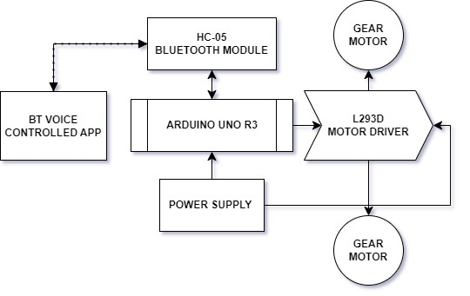
ARCHITECTURE DIAGRAM

Slide 12
MAJOR COMPONENTS
Arduino UNO board
AT mega 328p, black chip
HC-05 Bluetooth module
Dc motors 9v
9v battery
Gear motor 17
L293D motor drive 17

Slide 13
MODULES
Microphone Module:
Use a microphone module to capture audio input. Modules like KY-037 or KY-038 can be suitable for Voice Recognition
Module:
Consider modules like EasyVR (Voice Recognition Shield) or HM2007 for recognizing and processing voice commands.
Arduino Board:
Arduino Uno, Arduino Nano, or any other compatible Arduino board can serve as the brain of your bot. Motor Driver or Servo .
Motor:
If your bot involves movement, use a motor driver module (e.g., L298N) for controlling motors or servo motors for precise movements

Slide 14
MODULES
Power Supply:
Ensure a stable power supply, considering the power requirements of both the Arduino and the motors/servos.
LEDs or Buzzer:
Integrate LEDs or a buzzer to provide feedback when a command is received and executed. For safety, consider adding obstacle detection sensors (e.g., ultrasonic sensors like HC-SR04) to prevent collisions.
Bluetooth Module :
If you want to control the bot remotely via a smartphone, consider adding a Bluetooth module (e.g., HC-05 or HC-06).Chassis and Wheels : Depending on your bot's design, select a chassis and wheels suitable for your project .

Slide 15
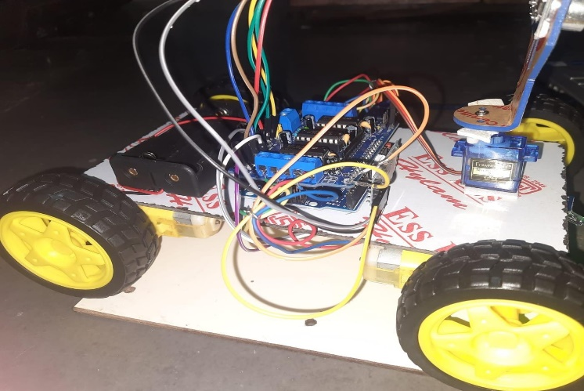
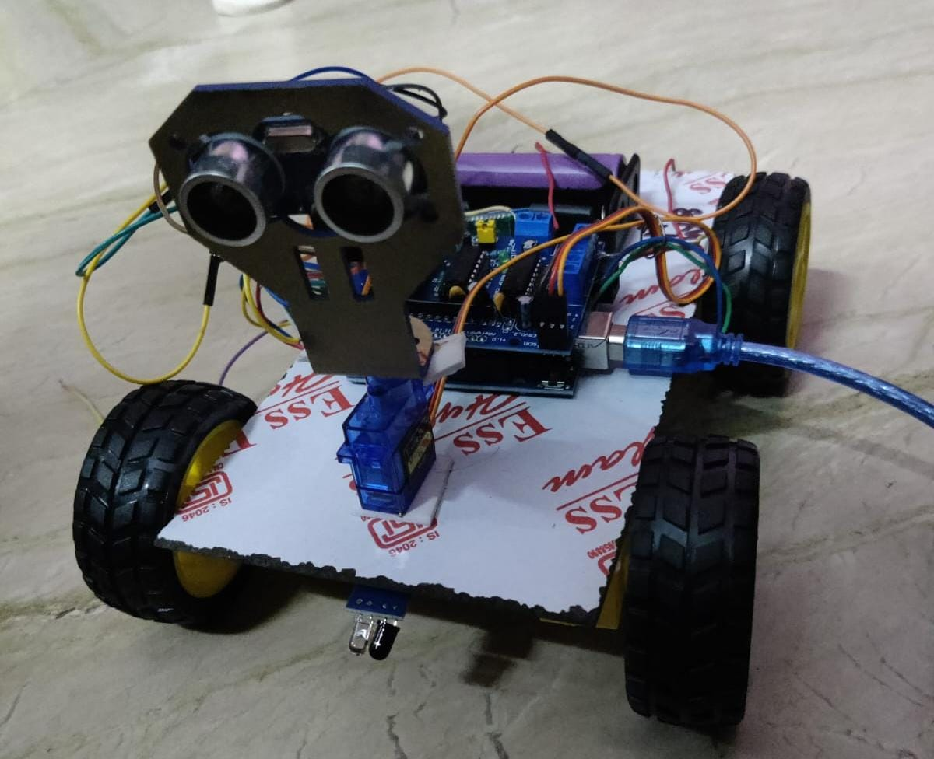
RESULT & DISCUSSION
The result of creating an Arduino-based voice-controlled robot vehicle would be a functional robot that responds to voice commands for movement.
Users can speak commands like "forward," "backward," "left," and "right," and the robot will execute these commands accordingly, moving in the specified direction.
With proper implementation and testing, you should have a reliable and entertaining robot vehicle that demonstrates the integration of voice recognition and motor control using Arduino.

Slide 16
FUTURE ENHANCEMENT
"The future prospects for a voice-controlled bot employing Arduino technology are highly promising, aligning seamlessly with the evolving trends in voice recognition, home automation, and the Internet of Things (IoT)
. Potential avenues for future development include seamless integration with smart home devices, accessibility solutions catering to individuals with disabilities, educational applications for interactive learning experiences, and healthcare applications for monitoring and assistance.

Slide 17
CONCLUSION
"In conclusion, the development of a voice control bot represents a significant leap forward in human-computer interaction, offering seamless integration of technology into daily life.
Our future scope is to include Internet of Things product offers a completely new direction to robotics.
To include artificial intelligence in the bot to identify the individual voice of the user
To include an Object tracking system to track the Objects so that it will avoid the collision.

Slide 18
REFERENCE
Kannan, K., & Selvakumar, J. (2015). Arduino based voice controlled robot. International Research Journal of Engineering and Technology (IRJET), 2(01), 49-55.
Vaibhav Tukaram Bengade,Kaustubh Avinash Chaudhari ,Nikhil Pundlik Fuke ,Vivek Pravin Kadam.Arduino based voice controlled robot UNO.International Research Journal of modernization in engeering technology and science (Vol. 993, No. 1, p. 012125). IOP Publishing.
Pawar Harshad, Jagtap Amol, Kamble Dnyaneshwar, Prof. Amol c. Bhosale
(2017). Voice control robot using Arduino pick and place object. International Journal of Innovations in Engineering Research and Technology, 4(6), 1-4
4.. Saleem Ullah, Zain Mumtaz, Shuo Liu, Mohammad Abu-Bakr, Athar Mahboob and Hamza Ahmad Madni, “Single-Equipment with Multiple- Application for an Automated Robot-Car Control System” Feb-2019.
5. Sumeet Sachdeva, Joel Macwana, Chintan Patela, Nishant Doshia. “VoiceControlled Autonomous vehicle Using IoT” (2019).
6. Ali A. Abed, “Design of Voice Controlled Smart Wheelchair” (2015)
7. M Saravanan et al 2020, “Arduino Based Voice Controlled Robot Vehicle”. [5] G Azam and M T Islam, “Design and Fabrication of a Voice Controlled Wheelchair for Physically Disabled People” (2019).

Slide 19
Thank You

